Slide 1
How to convert NetCDF to Points/ Polygons
What is NetCDF?
Dong-Hoon, Lee (이동훈)
dhl@gaia3d.com

Slide 2

For Someone who unfamiliar with multidimensional spatio-temporal data like netcdf or grib, I'd like to share how to convert them to points or grid polygons using Python's xarray and geopandas packages

Slide 3
What id NetCDF?
NetCDF (Network Common Data Form) is a set of software libraries and self-describing, machine-independent data formats that support the creation, access, and sharing of array-oriented scientific data
It is commonly used in climatology, meteorology and oceanography applications (e.g., weather forecasting, climate change) and GIS applications.
https://en.wikipedia.org/wiki/NetCDF
Climatology & Oceanography require time-series and three-dimensional measured information, NetCDF is so useful.

Slide 4
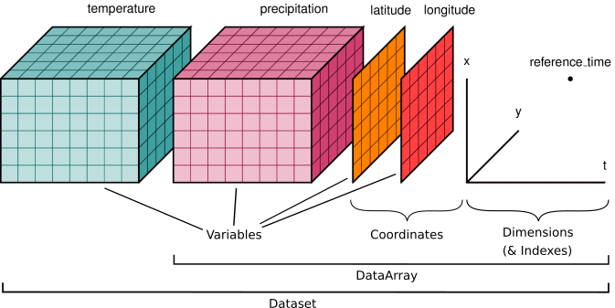
Multidimensional spatio-temporal data
NetCDF can store multidimensional spatio-temporal information
Xarray is a Python package that can use multidimensional spatio-temporal data including NetCDF
https://docs.xarray.dev/en/stable/user-guide/data-structures.html

Slide 5
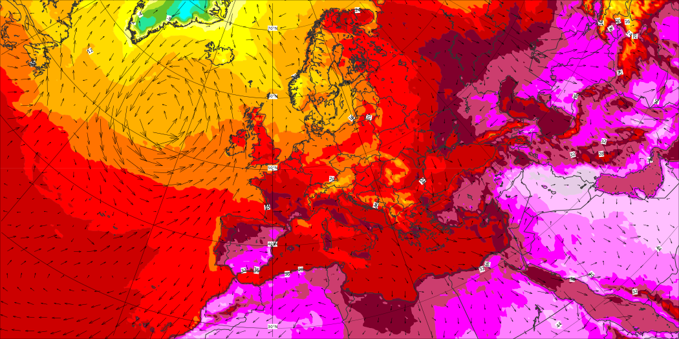
Where can you get that Data?
ECMWF (https://www.ecmwf.int/)
ECMWF is the European Centre for Medium-Range Weather Forecasts

Slide 6

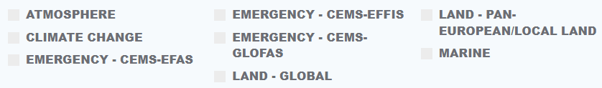
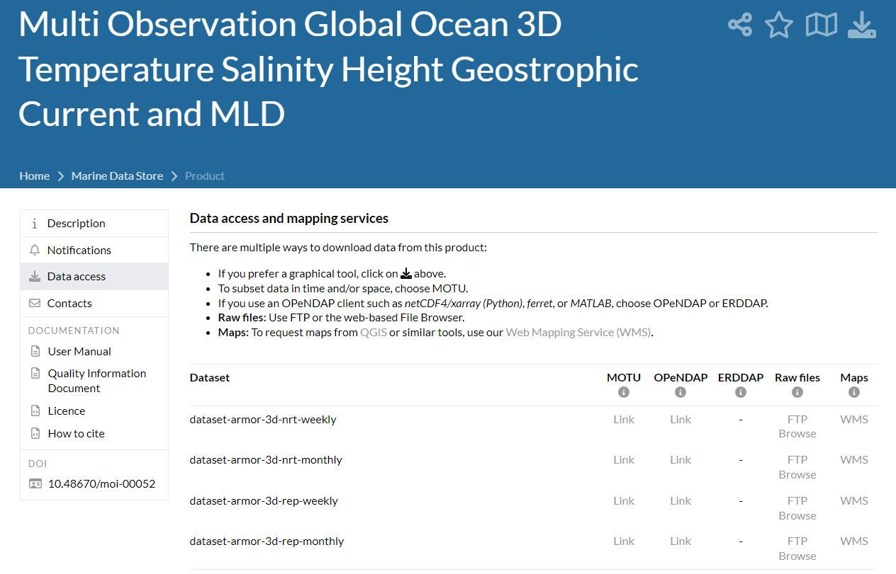
Copernicus (https://www.copernicus.eu/)
https://data.marine.copernicus.eu/product/MULTIOBS_GLO_PHY_TSUV_3D_MYNRT_015_012/services

Slide 7
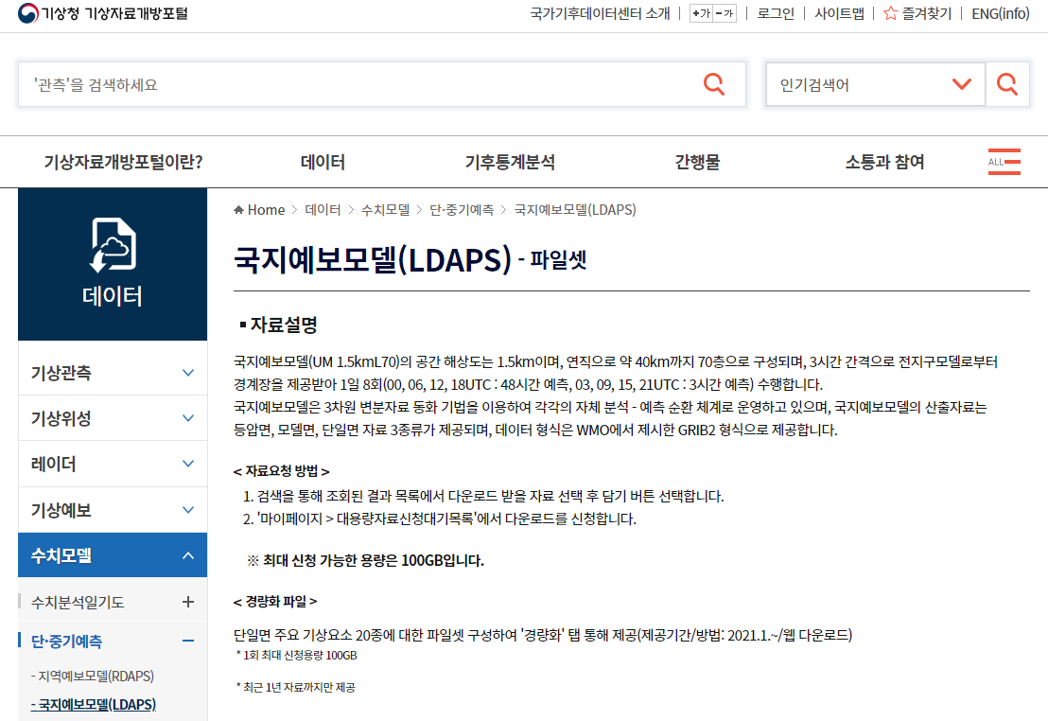
LDAPS and ETC…
https://data.kma.go.kr/data/rmt/rmtList.do?code=340&pgmNo=65
GRIB (GRIdded Binary or General Regularly-distributed Information in Binary form[1]) is a concise data format commonly used in meteorology to store historical and forecast weather data. It is standardized by the World Meteorological Organization's Commission for Basic Systems, known under number GRIB FM 92-IX, described in WMO Manual on Codes No.306
https://en.wikipedia.org/wiki/GRIB

Slide 8

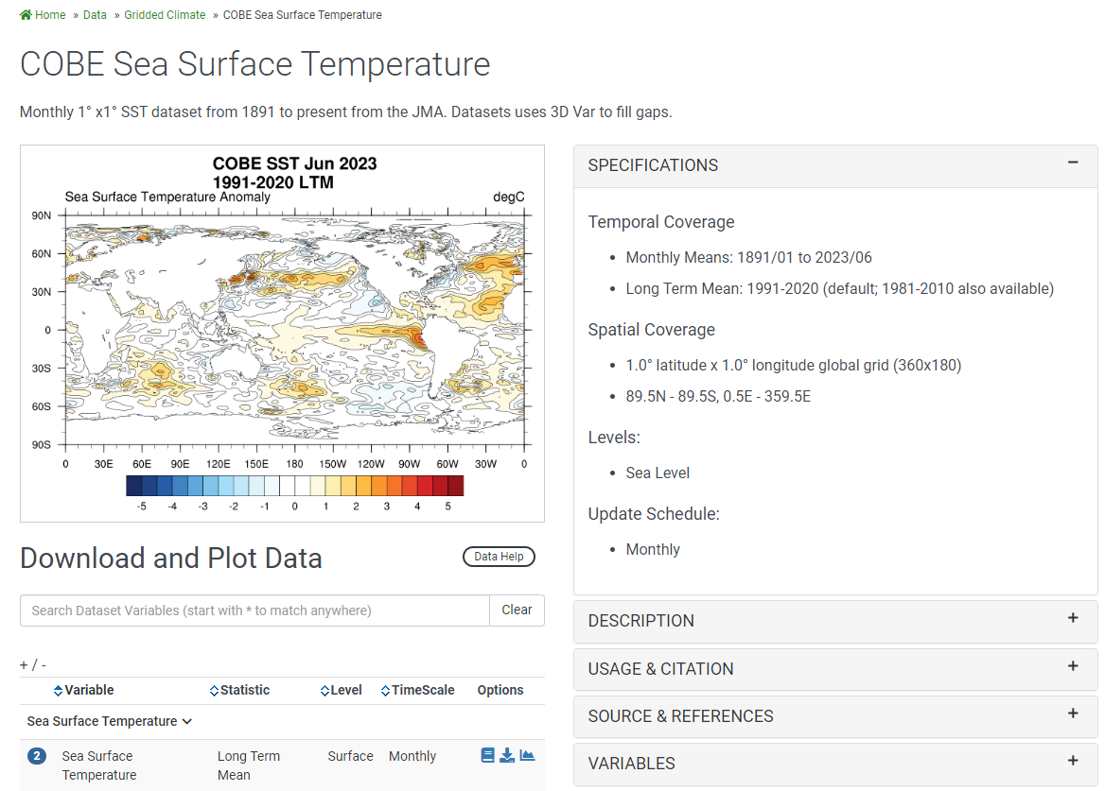
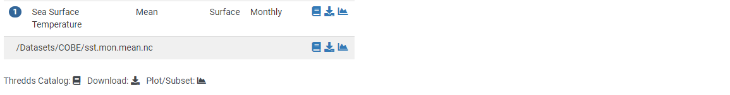
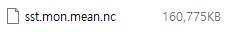
NOAA
https://psl.noaa.gov/data/gridded/index.html
https://psl.noaa.gov/data/gridded/data.cobe.html

Slide 9
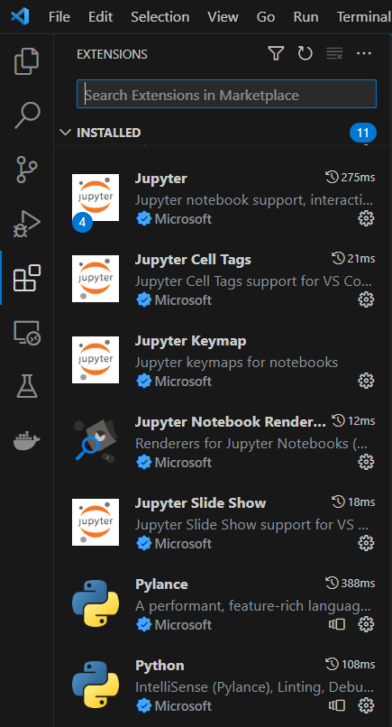
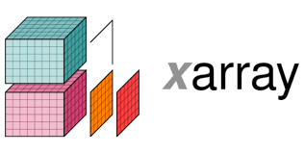




Data Processing Environment

Slide 10
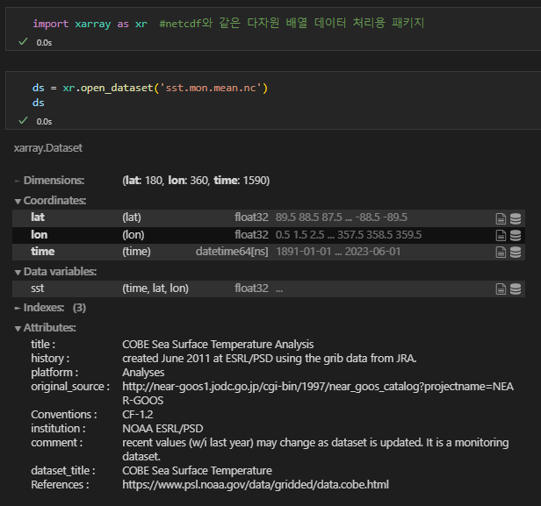
Loading NetCDF by using Xarray
import xarray package
loading data & View
Z(Depth/Height) Dimension also can be added
Dimension
Variables – Sea Surface Temperature
Metadata

Slide 11
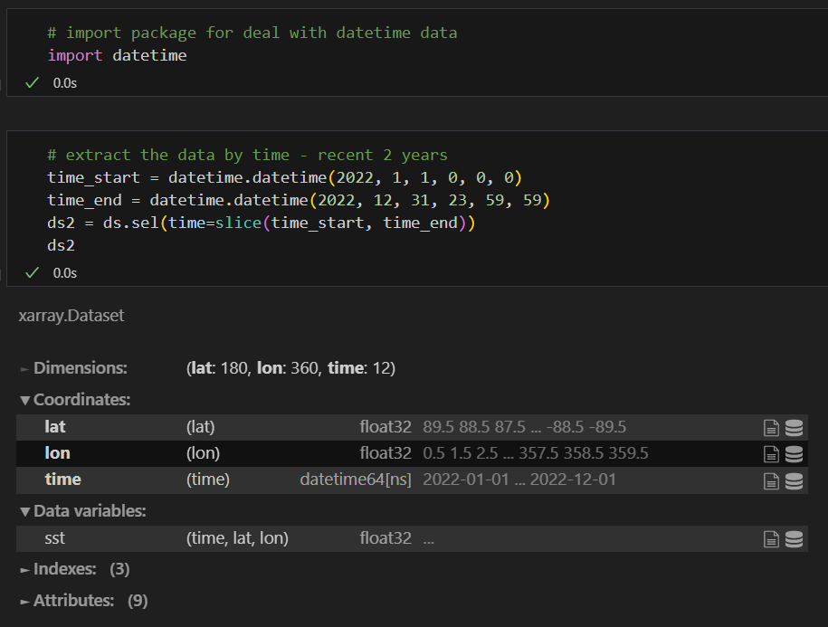
Extract data by temporal ranges
dataset.sel(time index=slice(start, end))

Slide 12
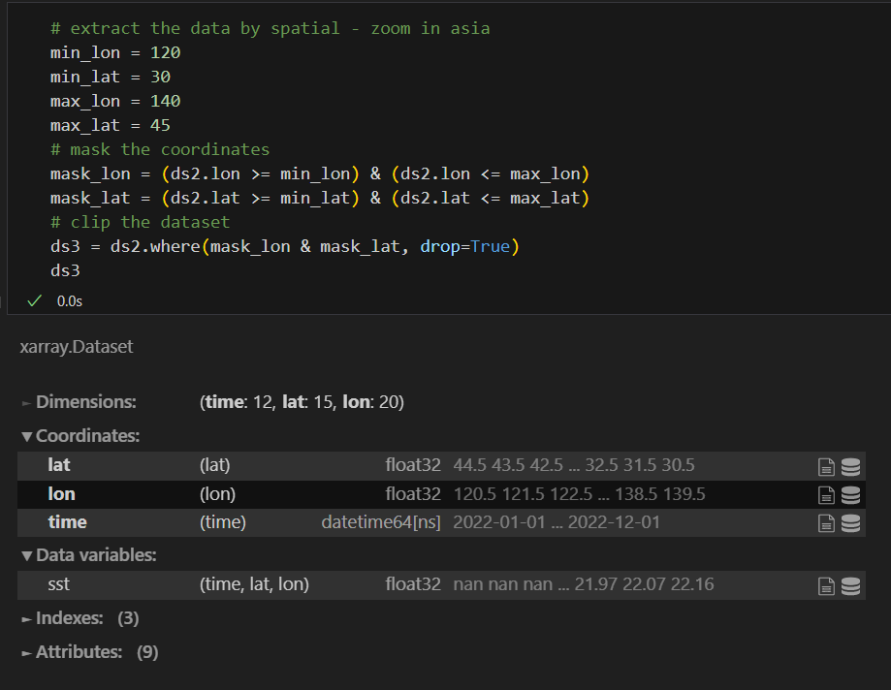
Extract data by spatial ranges
dataset.where(coordinates range)

Slide 13
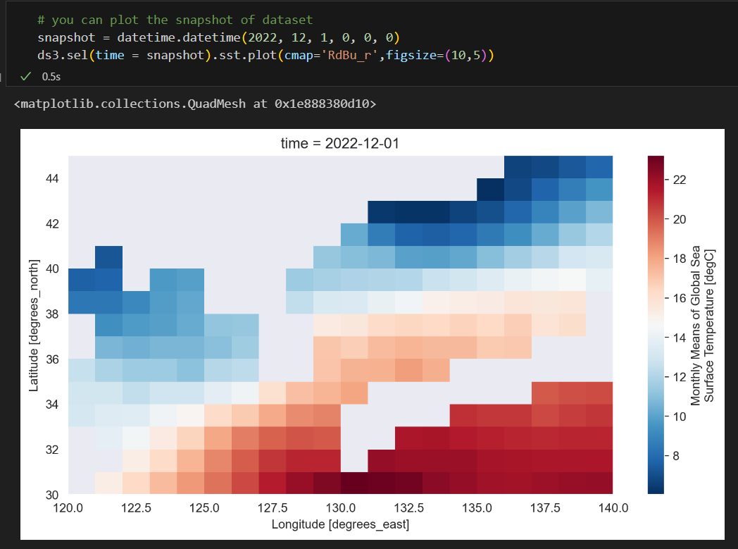
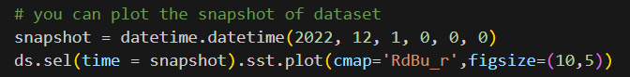
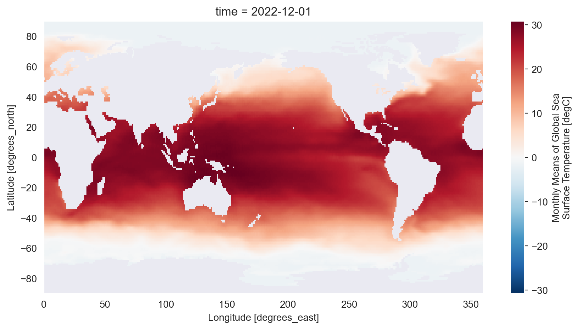
Plot the snapshot of dataset

Slide 14
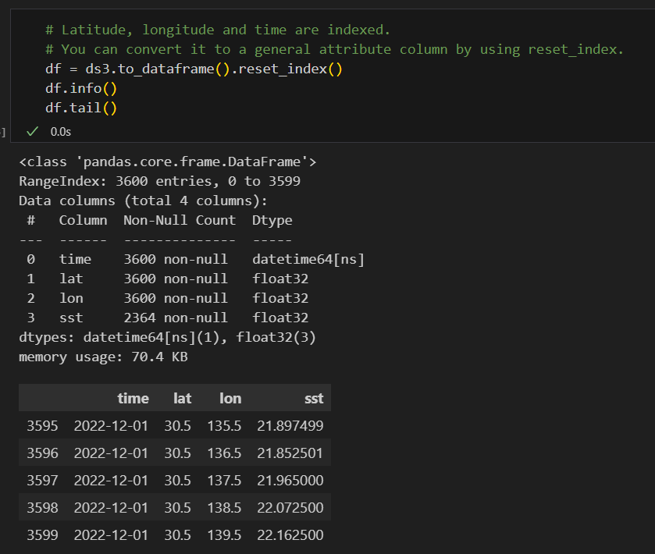
Now, convert NetCDF into Pandas DataFrame
using Xarray's to_dataframe

Slide 15
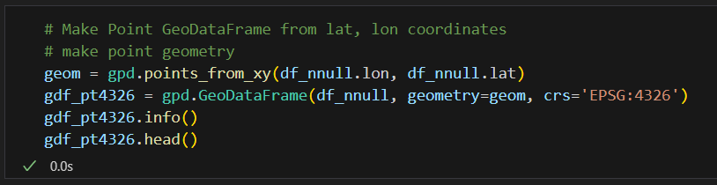
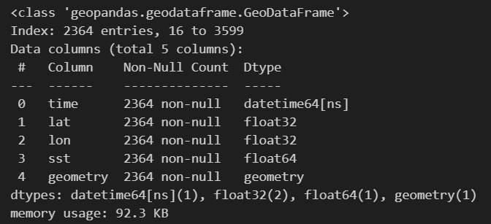
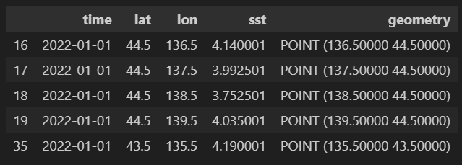
Make Point GeoDataFrame from lat, lon coordinates

Slide 16
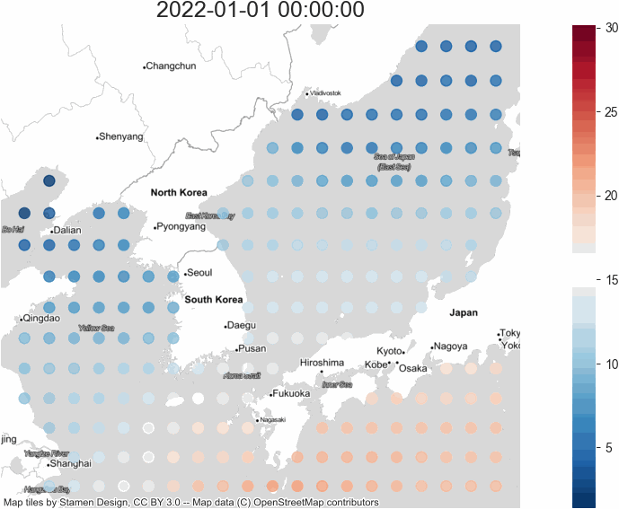
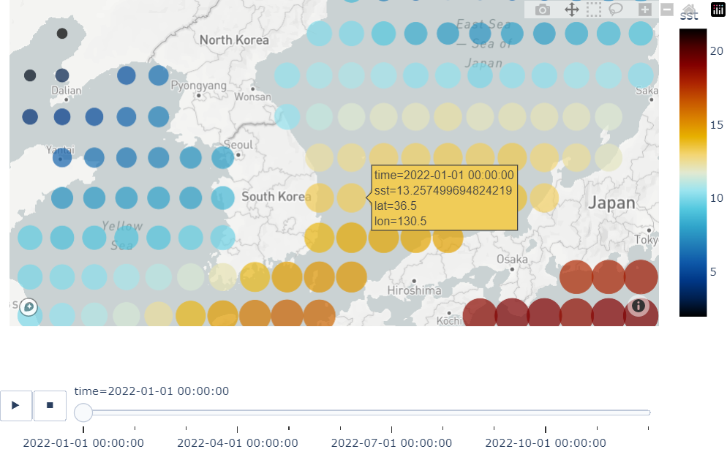
Make Map with Point (Time Animation)

Slide 17
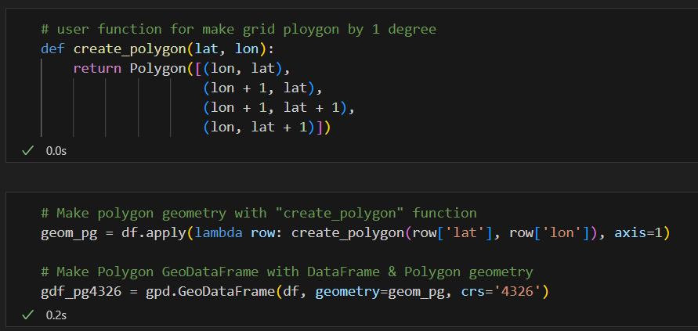
Make Polygon (Grid) Data

Slide 18
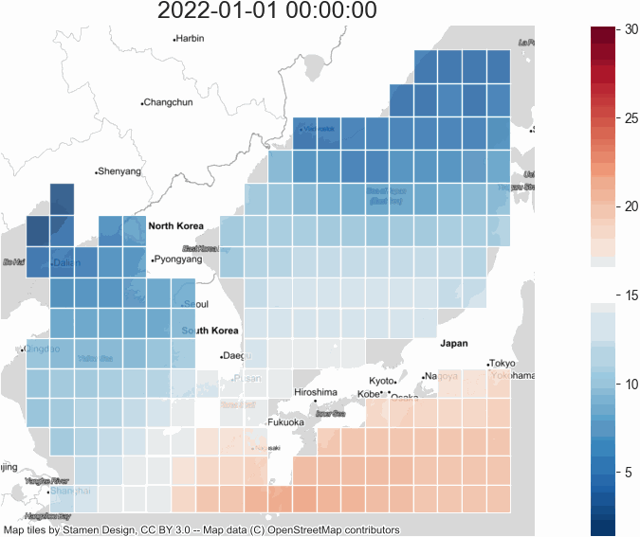
Make Map with Polygon Grid

Slide 19
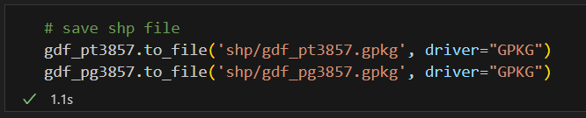
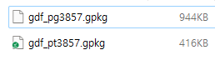
Save GIS File
Using GeoPandas

Slide 20
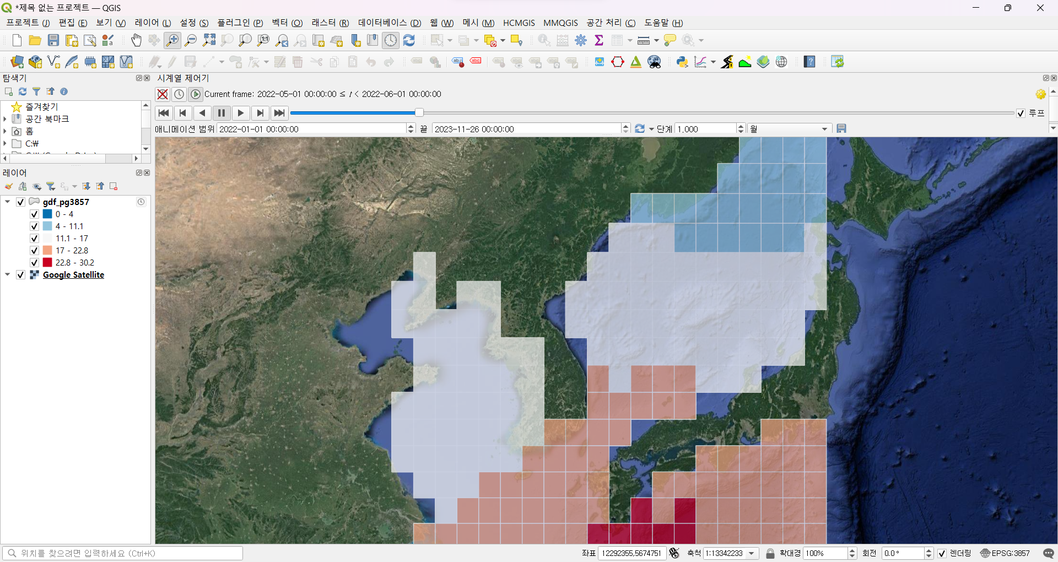
Using GeoPackage in QGIS or ETC

Slide 21
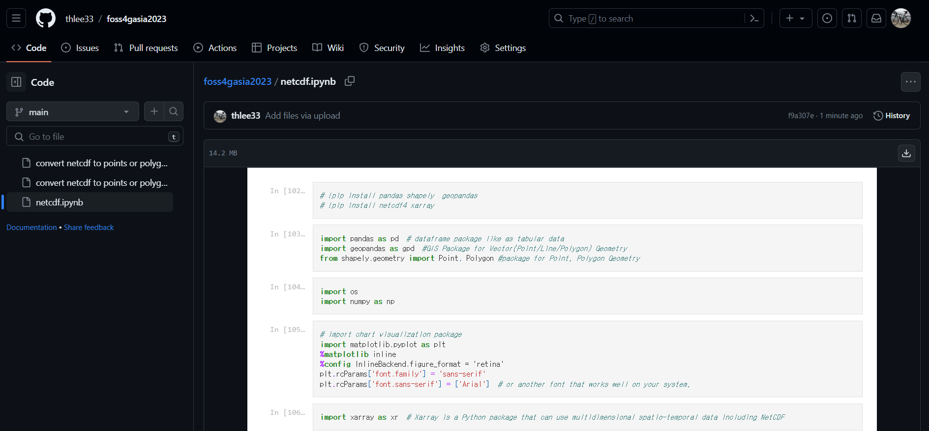
Get Jupyter Notebook
https://github.com/thlee33/foss4gasia2023

Slide 22
Thank You
Dong-Hoon, Lee (이동훈)
dhl@gaia3d.com

